Slide 1
FACULTY OF ENGINEERING
CAIRO UNIVERSITY
LAB 4 INTRODUCTION TO VHDL
CMP301A: COMPUTER ARCHITECTURE COURSE
EXERTED FROM DR. ADNAN SHAOUT- THE UNIVERSITY OF MICHIGAN-DEARBORN
Notes:
‹#›

Slide 2
OBJECTIVES
Declaring New Types.
Predefined operator.
How to initialize Memory.
Test-benches.

Slide 3
MEMORY / NEW TYPES …
Let’s Define the entity of the Ram Block of size 64 byte
What are the (input/outputs) for this circuit?
How many bits should represent each Input/Output ?
‹#›

Slide 4
MEMORY / NEW TYPES …
LIBRARY IEEE;
USE IEEE.STD_LOGIC_1164.ALL;
USE IEEE.numeric_std.all;
ENTITY ram IS
PORT (clk : IN std_logic;
we : IN std_logic;
address : IN std_logic_vector(5 DOWNTO 0);
datain : IN std_logic_vector(7 DOWNTO 0);
dataout : OUT std_logic_vector(7 DOWNTO 0) );
END ENTITY ram;
Architecture course
What is this library ?!
Write/read signal
INTRO TO VHDL
‹#›

Slide 5
ARCHITECTURE sync_ram_a OF ram IS
TYPE ram_type IS ARRAY(0 TO 63) of std_logic_vector(7 DOWNTO 0);
SIGNAL ram : ram_type ;
BEGIN
PROCESS(clk) IS
BEGIN
IF rising_edge(clk) THEN
IF we = '1' THEN
ram(to_integer(unsigned((address))) <= datain;
END IF;
END IF;
END PROCESS;
dataout <= ram(to_integer(unsigned((address)));
END sync_ram_a;
‹#›

Slide 6
Two Dimensional Array
ARCHITECTURE sync_ram_a OF ram IS
TYPE ram_type IS ARRAY(0 TO 63) of std_logic_vector(7 DOWNTO 0);
SIGNAL ram : ram_type ;
BEGIN
PROCESS(clk) IS
BEGIN
IF rising_edge(clk) THEN
IF we = '1' THEN
ram(to_integer(unsigned((address))) <= datain;
END IF;
END IF;
END PROCESS;
dataout <= ram(to_integer(unsigned((address)));
END sync_ram_a;
Defining a new type
Using the new Type
Remember the numeric Library ?! It contains this functions
What does synchronous mean ?!
Output here is asynchronous
‹#›

Slide 7
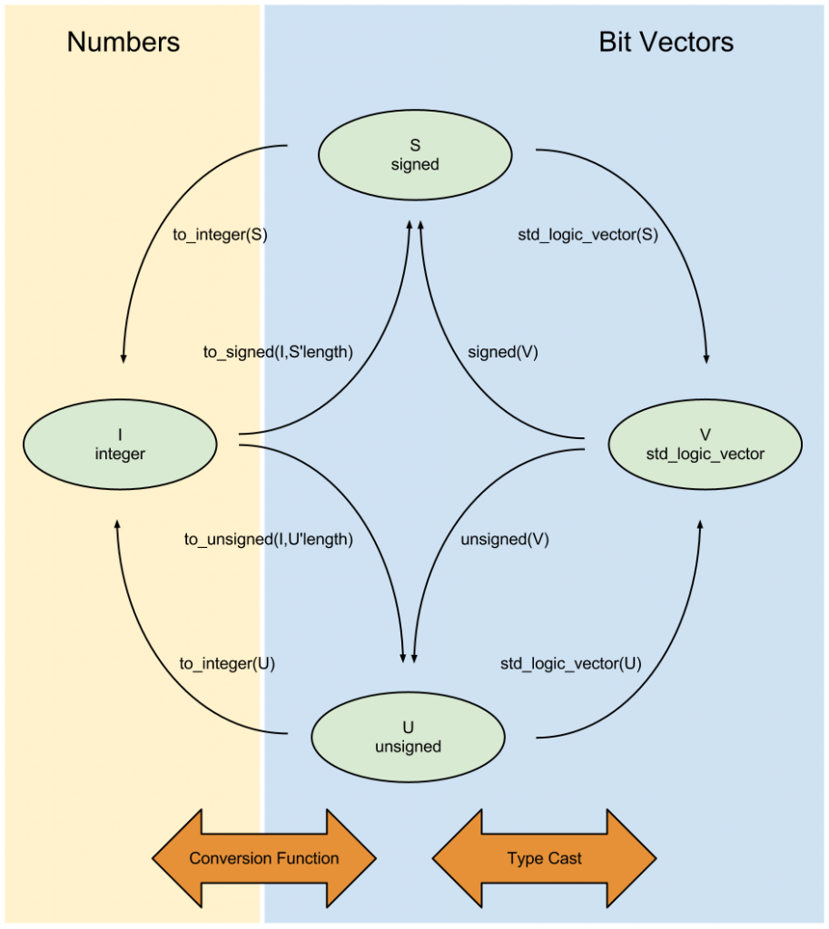
HTTP://WWW.BITWEENIE.COM/LISTINGS/VHDL-TYPE-CONVERSION/

Slide 8
MODELSIM TIME !
Architecture course
INTRO TO VHDL
‹#›

Slide 9
TEST BENCH EXAMPLE
-- Component under test
ENTITY and2 IS
PORT( a,b : IN std_logic;
z : OUT std_logic);
END and2;
ARCHITECTURE anda OF and2 IS
BEGIN
z <= a AND b;
END and_a;

Slide 10
ENTITY testbench IS
END testbench;
ARCHITECTURE testbench_a OF testbench IS
COMPONENT and2 IS
PORT ( a,b : IN std_logic; z : OUT std_logic);
END COMPONENT;
SIGNAL testa, testb, testz : std_logic;
BEGIN
PROCESS
BEGIN
testa <= '0';
testb <= '0';
WAIT FOR 10 ns;
ASSERT(testz = ‘0’) REPORT “z is not 0 for 00”
SEVERITY ERROR;
testa <= '0';
testb <= ‘1';
WAIT FOR 10 ns;
ASSERT(testz = '0’) REPORT “z is not 0 for 01”
SEVERITY ERROR;
testa <= '1';
testb <= '0';
WAIT FOR 10 ns;
ASSERT(testz = '0’) REPORT “z is not 0 for 10”
SEVERITY ERROR;
testa <= '1';
testb <= ‘1';
WAIT FOR 10 ns;
ASSERT(testz = '1’) REPORT “z is not 1 for 11”
SEVERITY ERROR;
WAIT;
END PROCESS;
uut: and2 PORT MAP (a => testa, b => testb, z =>testz);
END testbench_a;
Notes:
‹#›

Slide 11
ENTITY testbench IS
END testbench;
ARCHITECTURE testbench_a OF testbench IS
COMPONENT and2 IS
PORT ( a,b : IN std_logic; z : OUT std_logic);
END COMPONENT;
SIGNAL testa, testb, testz : std_logic;
BEGIN
PROCESS
BEGIN
testa <= '0';
testb <= '0';
WAIT FOR 10 ns;
ASSERT(testz = ‘0’) REPORT “z is not 0 for 00” SEVERITY ERROR;
testa <= '0';
testb <= ‘1';
WAIT FOR 10 ns;
ASSERT(testz = '0’) REPORT “z is not 0 for 01”
SEVERITY ERROR;
testa <= '1';
testb <= '0';
WAIT FOR 10 ns;
ASSERT(testz = '0’) REPORT “z is not 0 for 10”
SEVERITY ERROR;
testa <= '1';
testb <= ‘1';
WAIT FOR 10 ns;
ASSERT(testz = '1’) REPORT “z is not 1 for 11”
SEVERITY ERROR;
WAIT;
END PROCESS;
uut: and2 PORT MAP (a => testa, b => testb, z =>testz);
END testbench_a;
Empty entity
The process and the component works in parallel
Entity under test
Why used signals instead of variables ?!
Variables will not be seen outside process
Process with No sensitivity list ?!
Remember Signal takes time to get value
To stop looping forever
Instantiating the component to be tested
If the condition is true , then it doesn’t report
‹#›

Slide 12
Can’t We just use a loop instead of writing cases ?
PROCESS
CONSTANT outCases : std_logic_vector(0 to 3) :="0001";
BEGIN
For i in 0 to 3 Loop
test(2 downto 1) <= std_logic_vector(to_unsigned(i,2));
WAIT FOR 10 ns;
ASSERT(test(0) = outCases(i)) REPORT " Z is not " &std_logic'image(outCases(i))&" zero for "&integer'image(i)
SEVERITY ERROR;
end loop;
WAIT;
END PROCESS;

